Slide 1
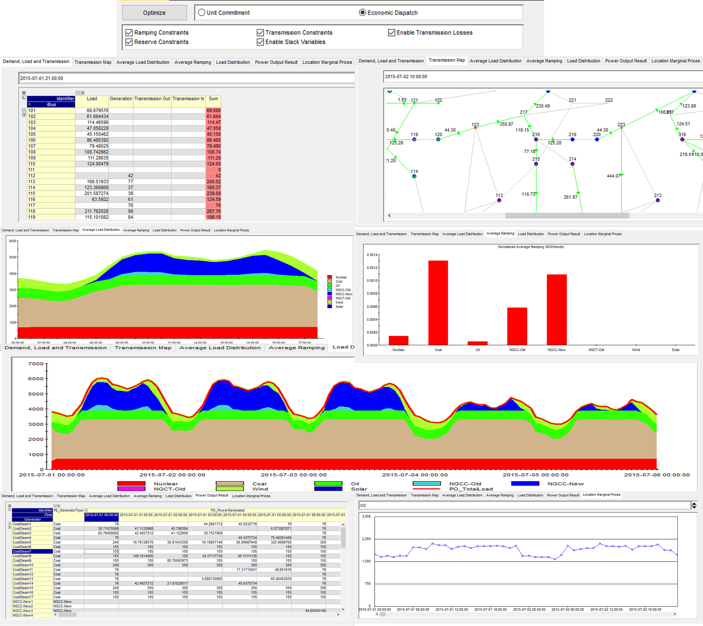
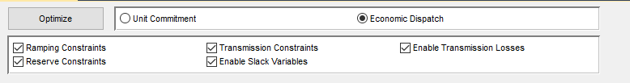
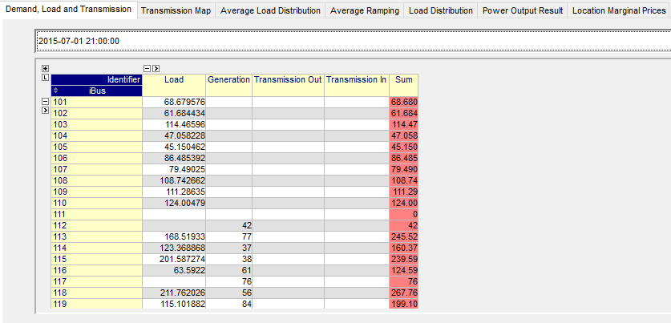
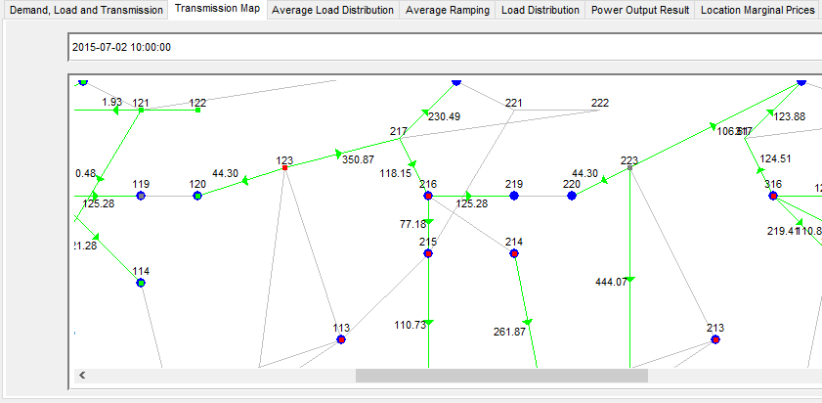
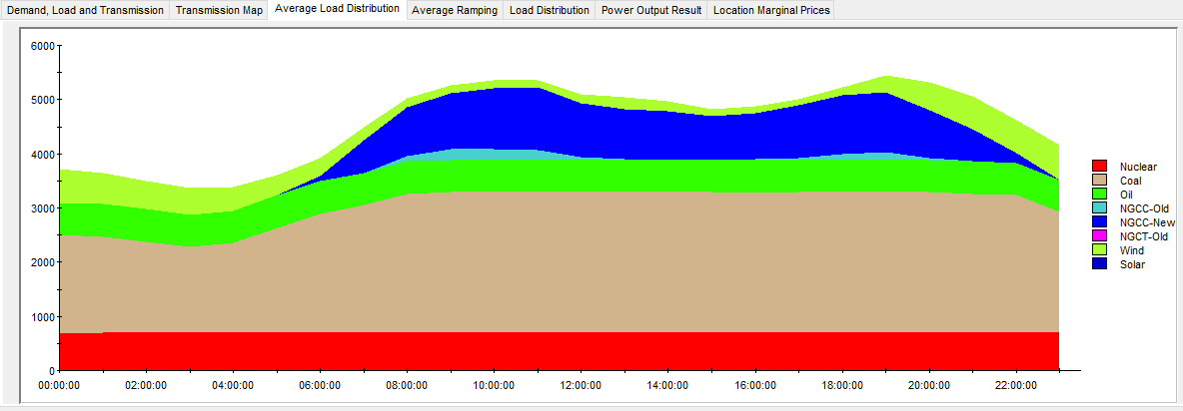
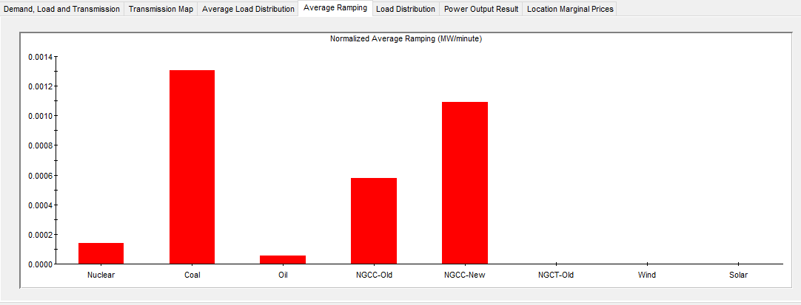
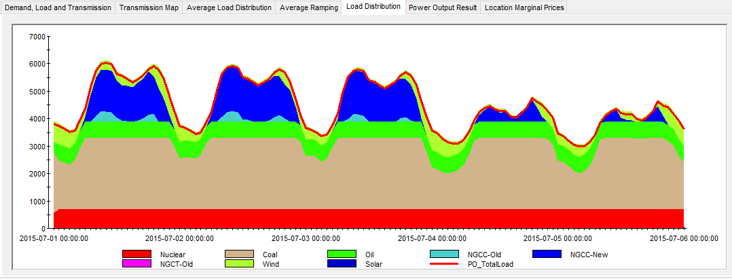
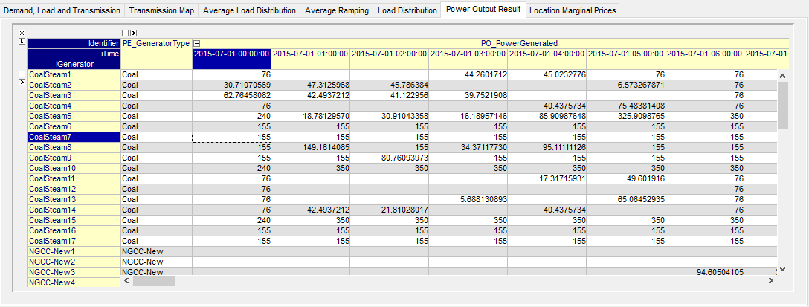
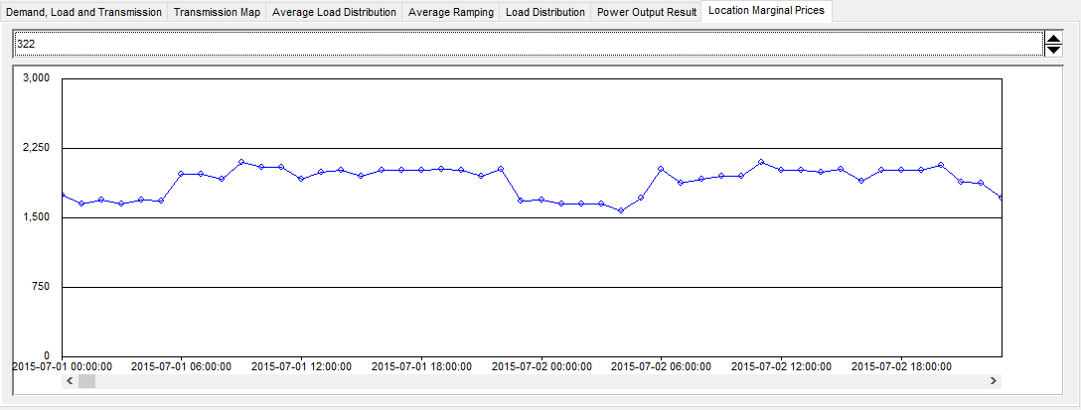

Slide 2
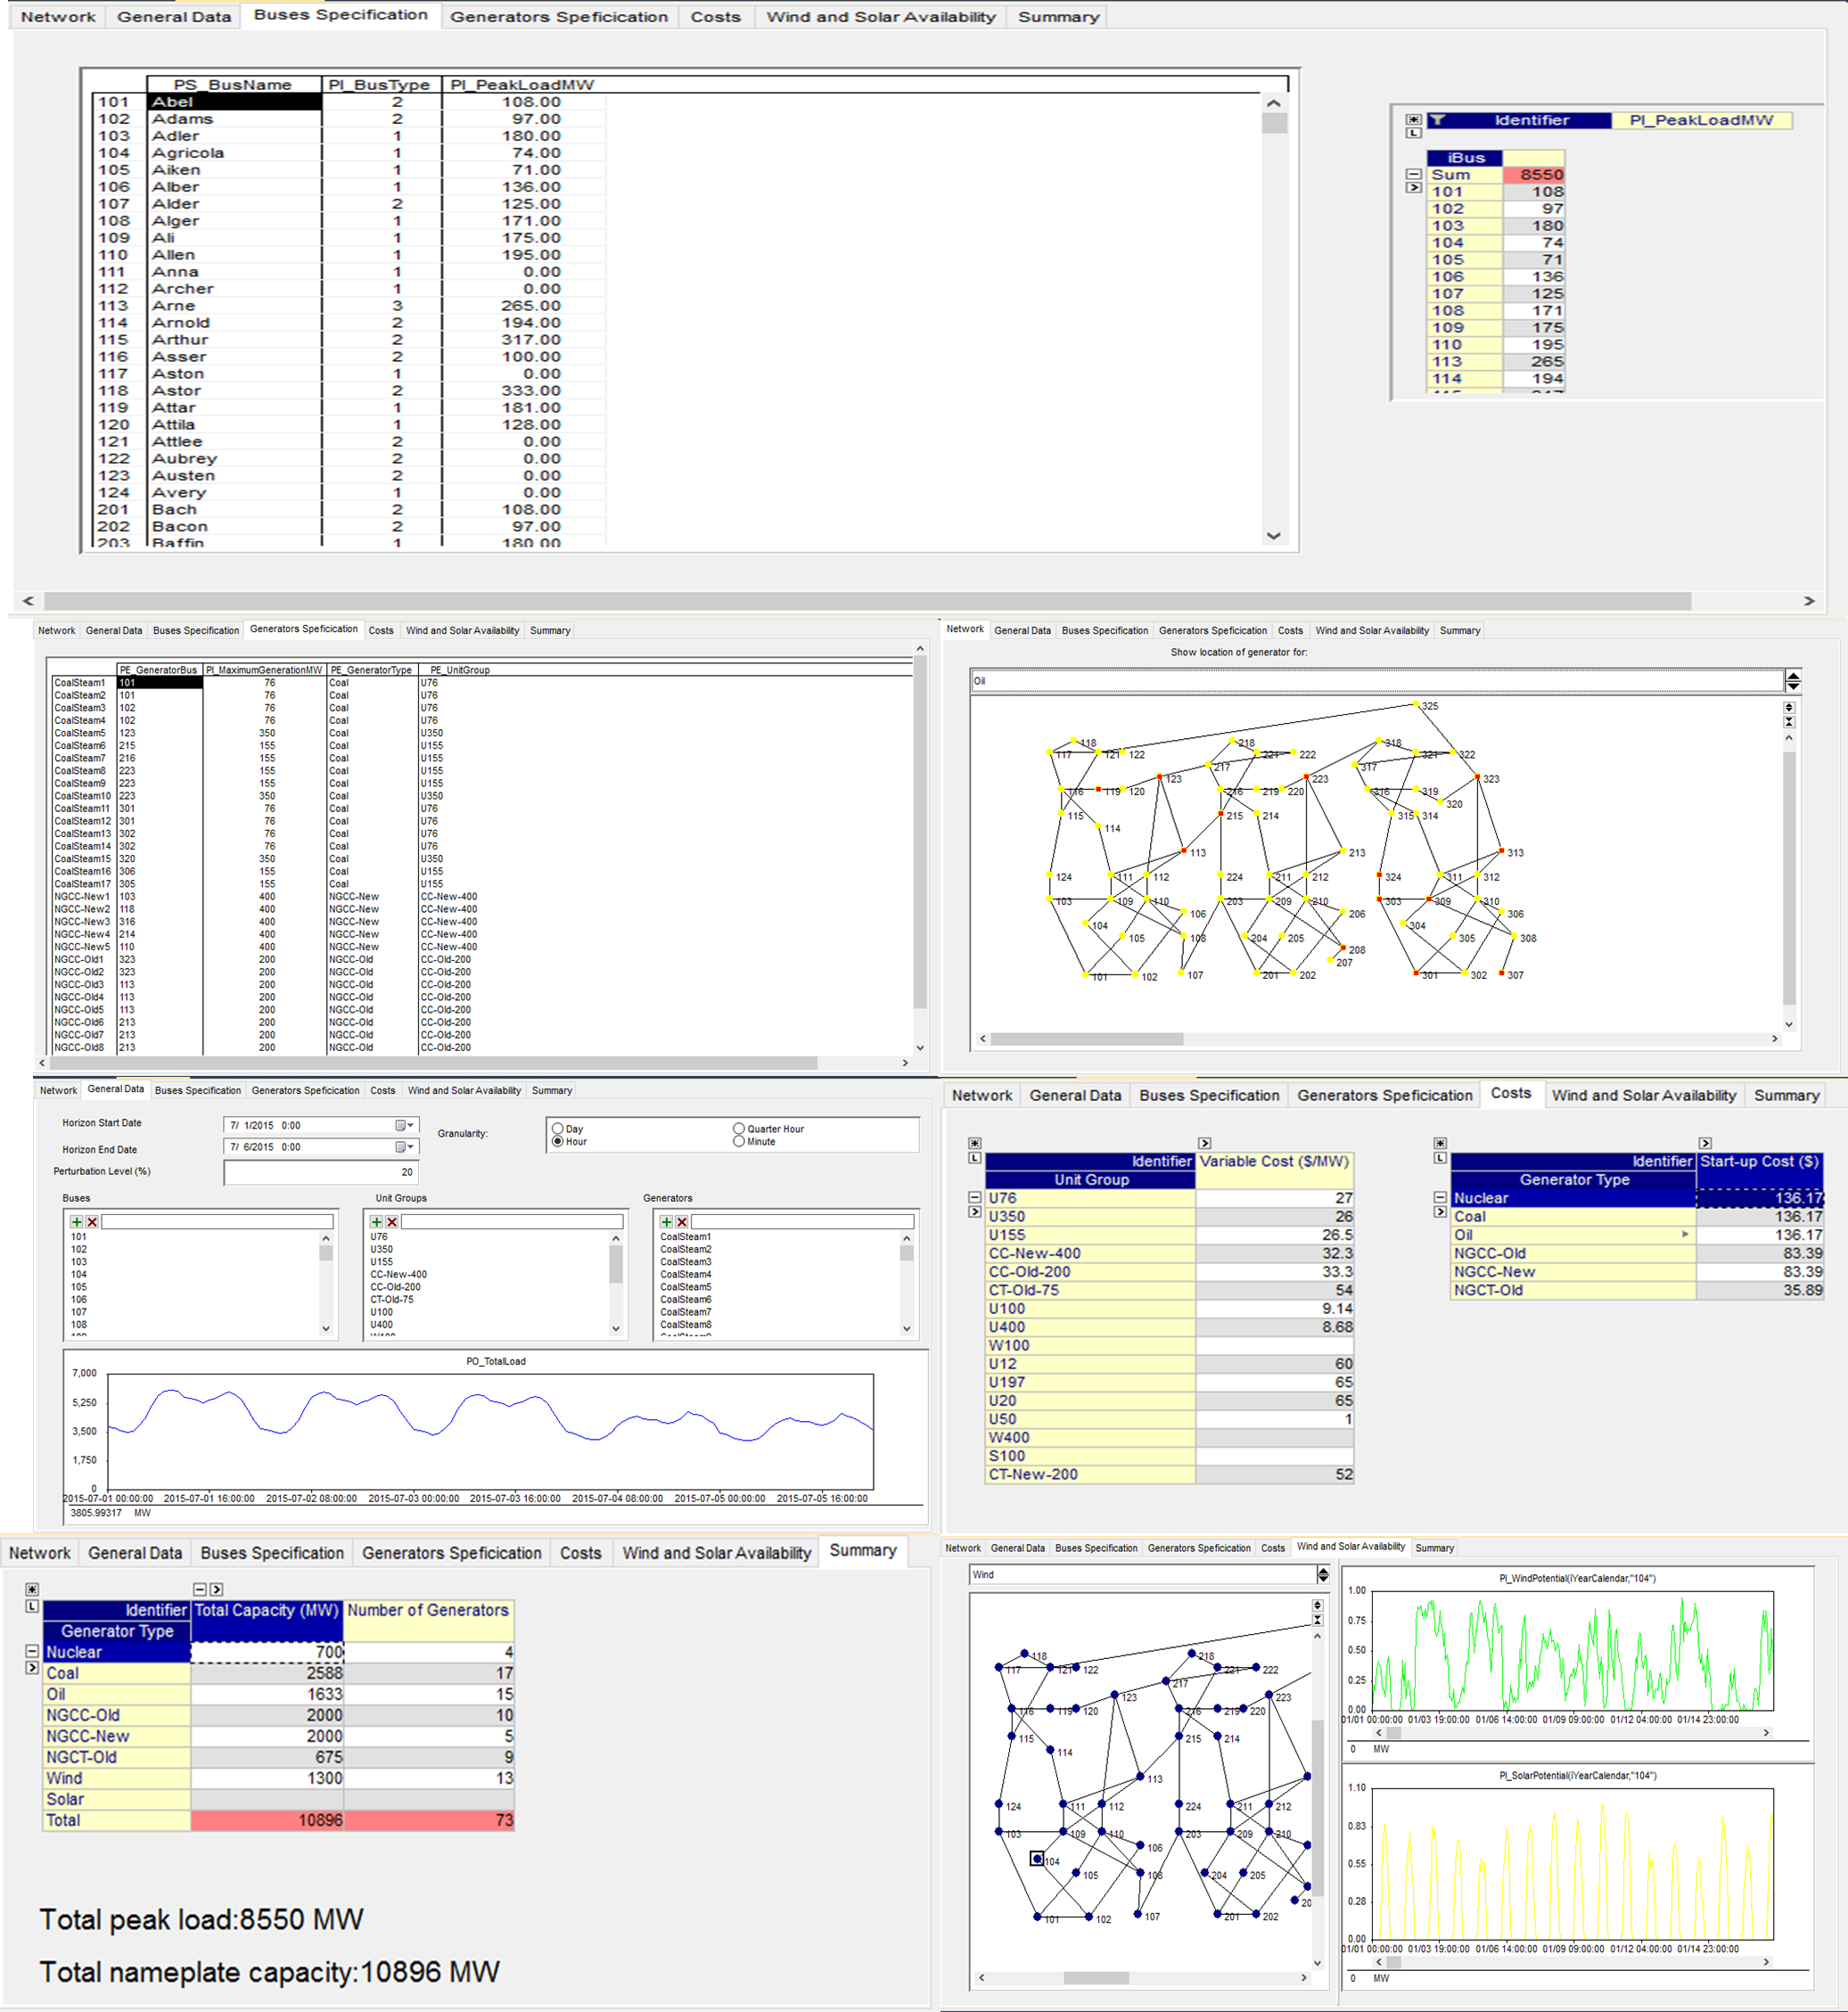
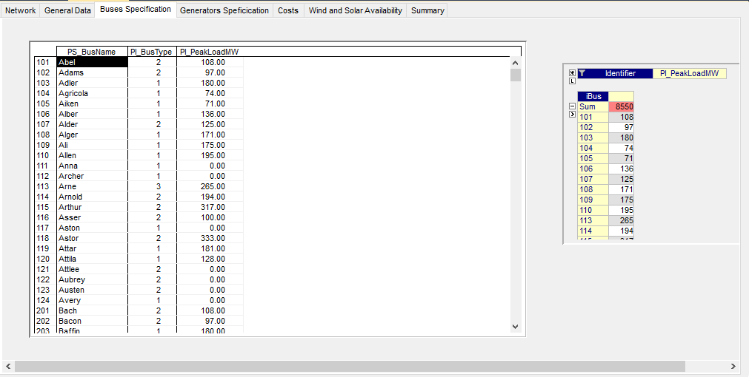
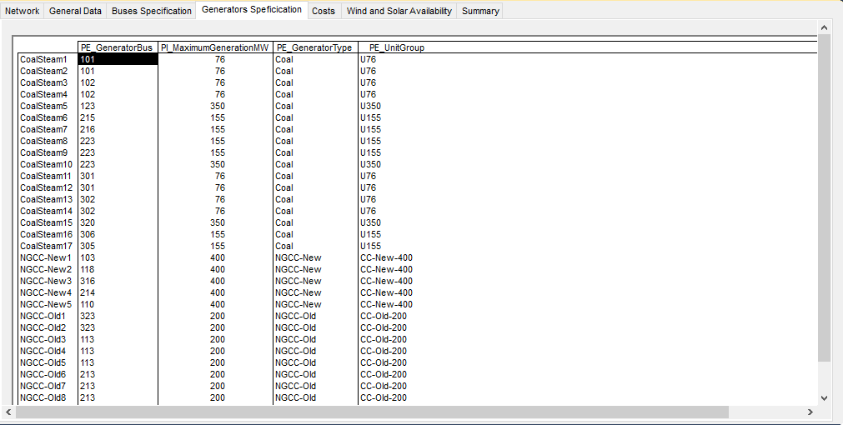
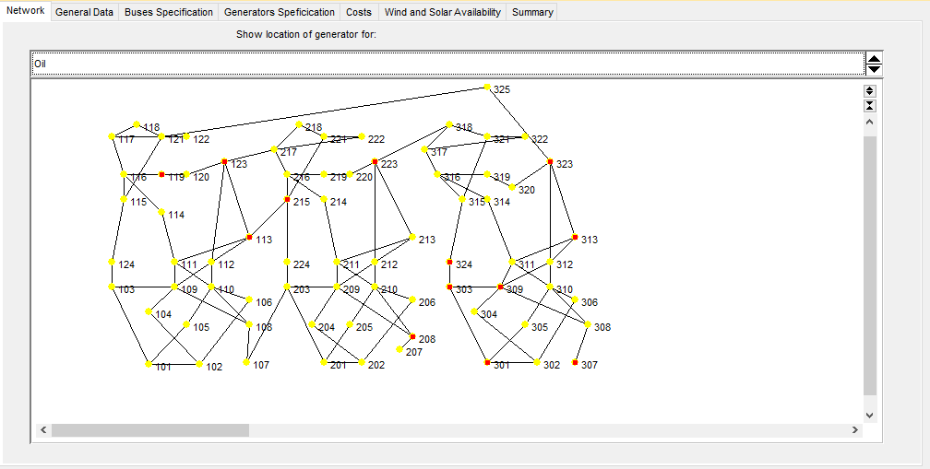
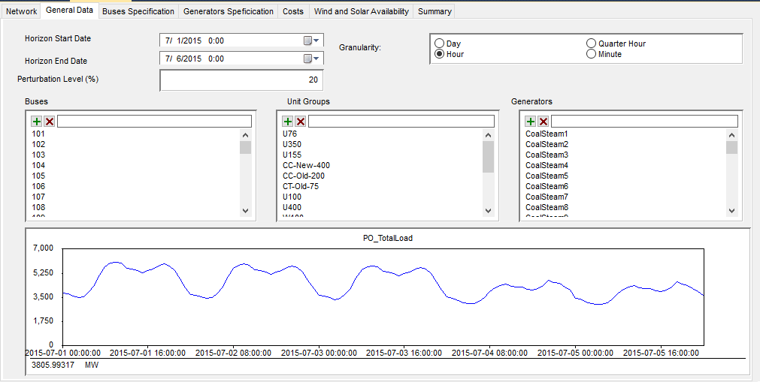
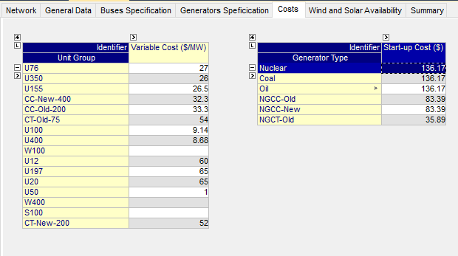
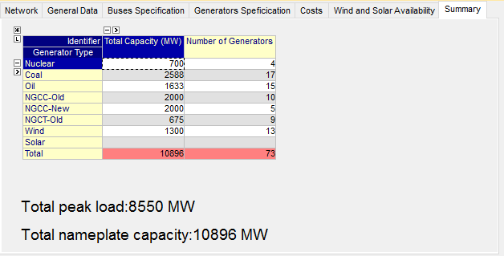
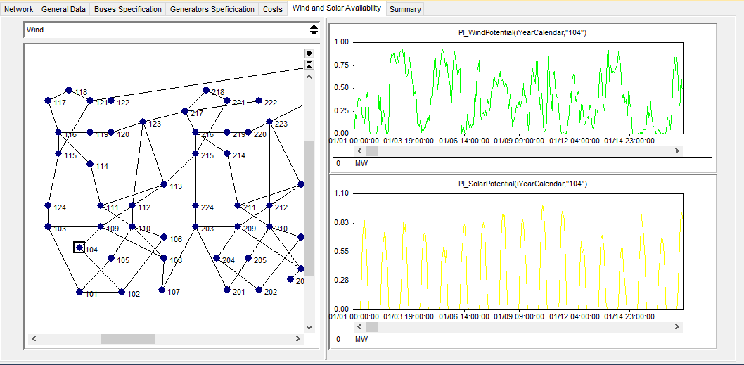

Slide 3
Power Output(MW) – Scenario 1
60 minutes
15 minutes
5 minutes
Transmission Off
Economic Dispatch
Unit Commitment
Transmission On
Economic Dispatch
Unit Commitment

Slide 4
Power Output(MW) – Scenario 2
60 minutes
15 minutes
5 minutes
Transmission Off
Economic Dispatch
Unit Commitment
Transmission On
Economic Dispatch
Unit Commitment

Slide 5
Power Output(MW) – Scenario 3
60 minutes
15 minutes
5 minutes
Transmission Off
Economic Dispatch
Unit Commitment
Transmission On
Economic Dispatch
Unit Commitment

